Slide 1


Historical Timeline of Computer Vision
ITAI 1378- Introduction to Computer Vision
Professor: Patricia McManus
Group 4
Kaire Campomanes
Dallas Foster
Elijah Ghaya
Hisham Macaraya
Katherine Stanton
Text to speech courtesy of Amazon Polly

Slide 2
1957-First Digital Image Scanned
In 1957, Russel Kirsch created the first digital image (PDF) by scanning a photo of his son using a rotating drum scanner. “He mounted the photo on a rotating drum scanner that had a motor on one end and a strobing disk on the other.” ^{[3]} Kirsch has been coined the father of digital imaging and was a pioneer in pixel technology. (Pixel is an amalgamation of picture element.)
Source: [3] https://hackaday.com/2020/08/20/russell-kirsch-pixel-pioneer-and-the-father-of-digital-imaging/

Slide 3
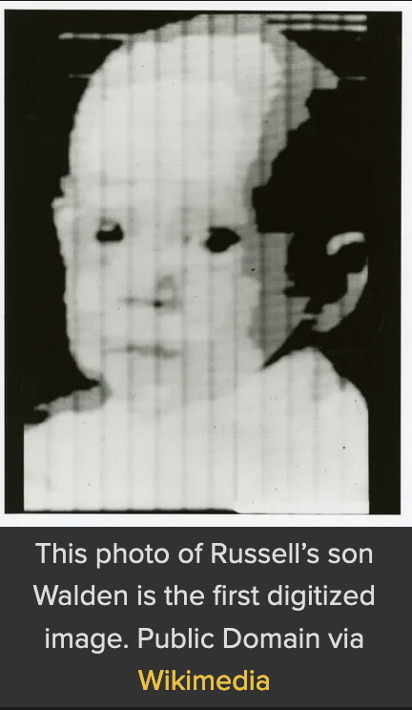
1957-First Digital Image Scanned
Source: https://hackaday.com/2020/08/20/russell-kirsch-pixel-pioneer-and-the-father-of-digital-imaging/

Slide 4
Late 1950’s- Frank Rosenblatt’s Perceptron
Also in 1957, Frank Rosenblatt created The Perceptron, an artificial neuron, which was a perceiving and recognizing automaton, laying the groundwork for today’s neural networks. ^{[6]}
Source: [6] https://medium.com/@robdelacruz/frank-rosenblatts-perceptron-19fcce9d627f

Slide 5
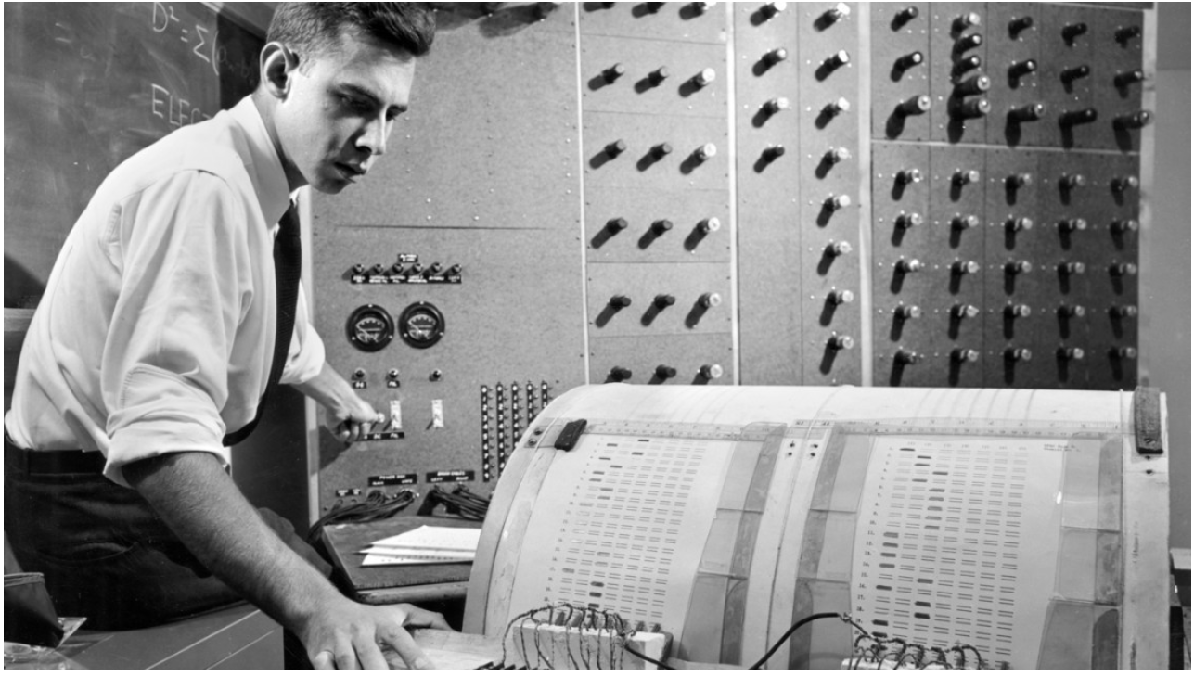
Late 1950’s- Frank Rosenblatt’s Perceptron
Source: https://news.cornell.edu/stories/2019/09/professors-perceptron-paved-way-ai-60-years-too-soon

Slide 6
1959-Hubel and Wiesel’s Nobel Prize Winning Research on Cats
IBM traces the origin of computer vision to 1959, when neurophysiologists David Hubel and Torsten Wiesel of Harvard Medical School, began experimenting on cats with the goal of gaining insight into the neurological responses of cats to visual stimuli. “They discovered that it responded first to hard edges or lines and specifically, this meant that image processing starts with simple shapes like straight edges.” ^{[1]} Valeriia Kuka for Turing Post states that “Hubel and Wiesel’s findings…uncovered the visual cortex’s hierarchical and modular organization.” ^{[2]}
Sources: [1] https://www.ibm.com/topics/computer-vision
[2] https://www.turingpost.com/p/cvhistory2

Slide 7
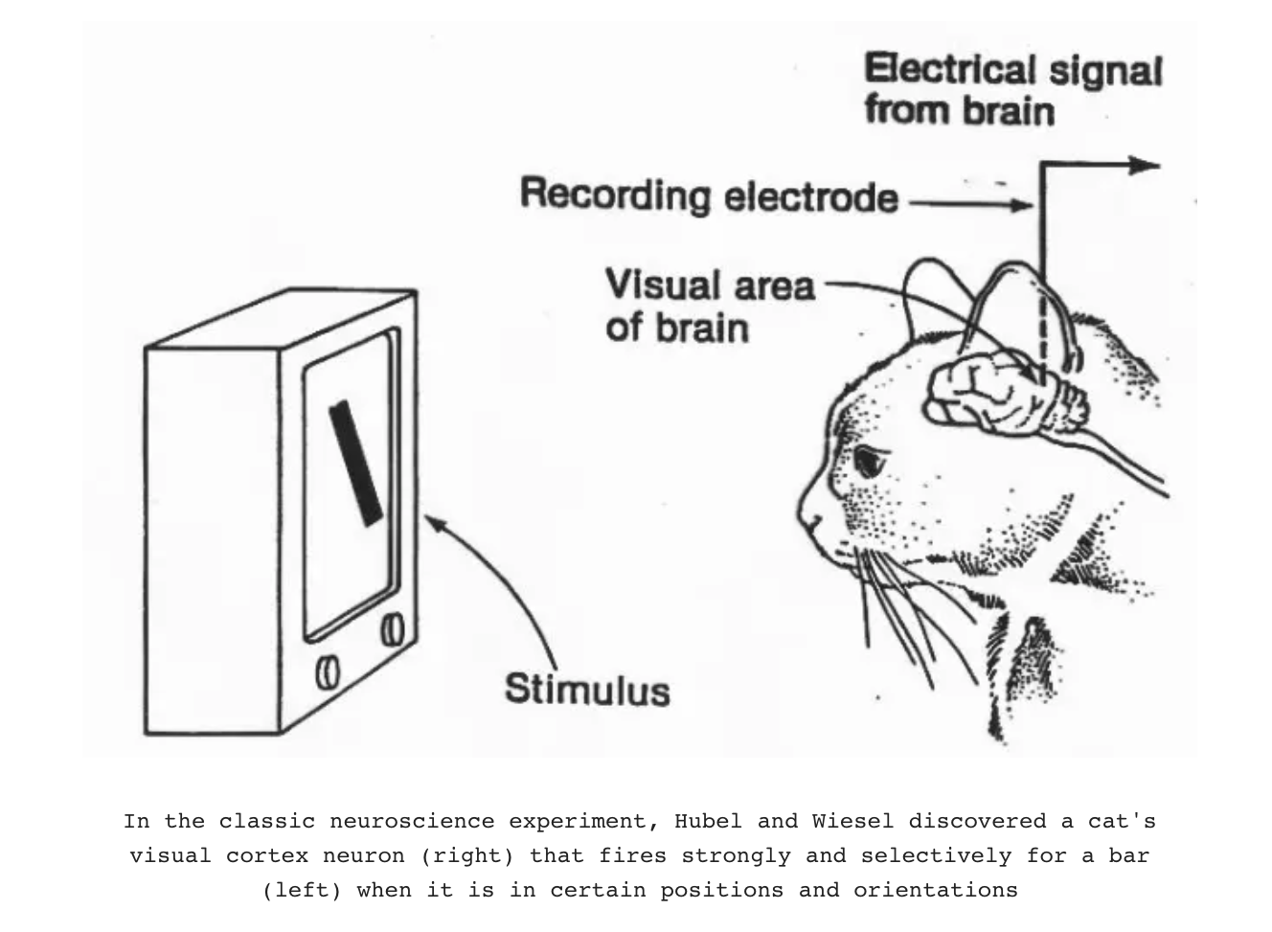
1959-Hubel and Wiesel’s Nobel Prize Winning Research on Cats
Source: https://www.turingpost.com/p/cvhistory2

Slide 8
1963- Larry Robert’s Thesis on Machine Perception
In 1963, Larry Roberts at MIT published his thesis, “Machine Perception of Three-Dimensional Solids,” in which he “introduced algorithms that could reconstruct the three-dimensionality of a scene from a two-dimensional image. Robert’s thesis “marked a surge in interest in… ‘machine perception’ - the capability of a computer system to interpret data in a manner humans use their senses to relate to the world around them.” ^{[2]}
Source: https://www.turingpost.com/p/cvhistory2

Slide 9
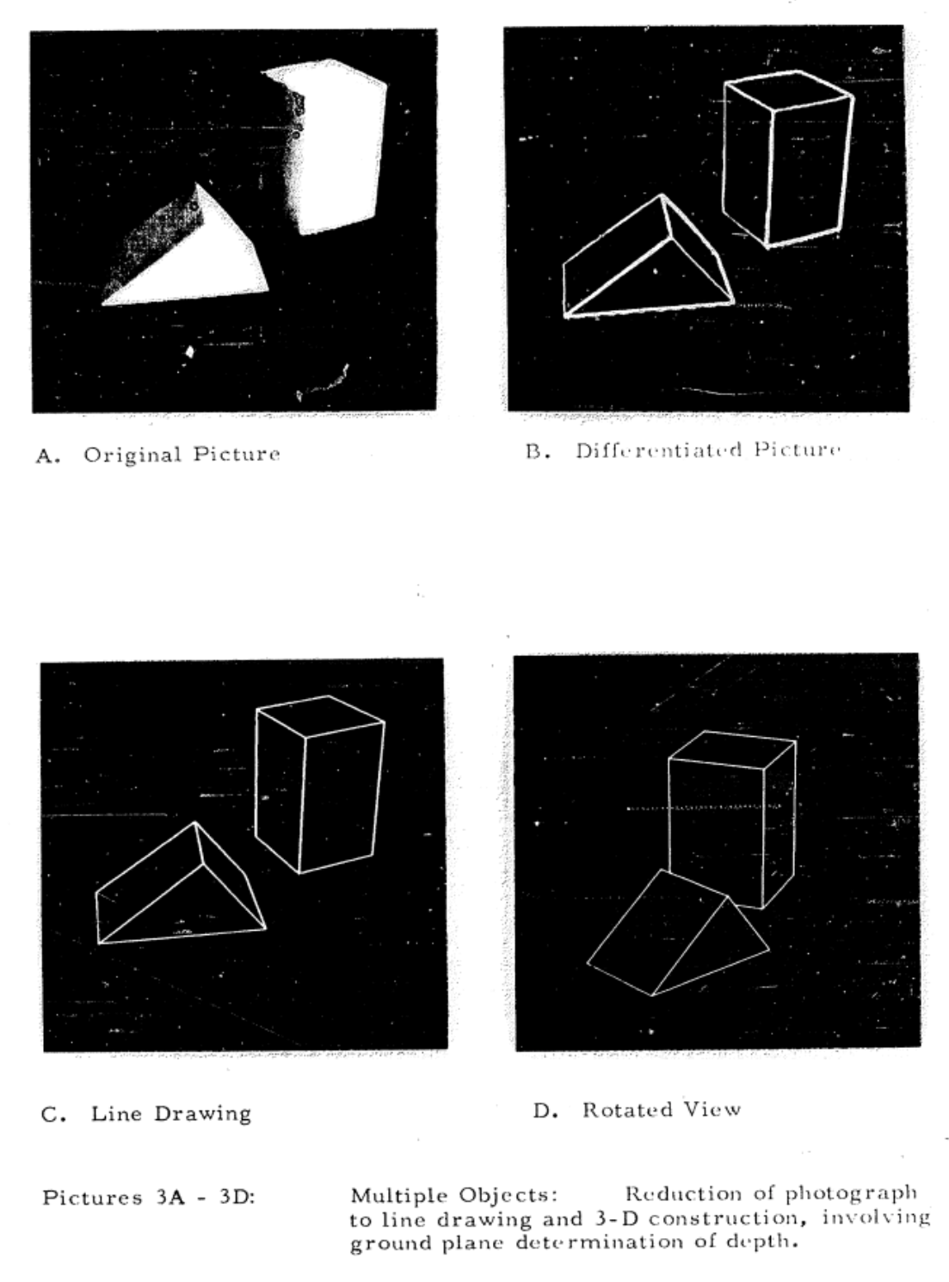
1963- Larry Robert’s Thesis on Machine Perception
Source: https://www.turingpost.com/p/cvhistory2

Slide 10
1966- The summer Vision ProJect
In 1966, MIT professors Seymour Papert and Marvin Minksy, formed the Summer Vision Project with the intent of addressing problems in machine vision of the time and with the hopes of progressing development of pattern recognition. Abirami Vina for Medium states; Papert and Minksy challenged students to “develop a significant component of a visual system in one summer. The students tried to create a platform capable of automatically differentiating between the foreground and background in images, as well as extracting distinct objects without any overlapping, all from real-world scenes.” ^{[4]}
https://medium.com/data-and-beyond/a-historical-investigation-into-the-beginning-of-computer-vision-8e86858254bd
Source: [4]

Slide 11
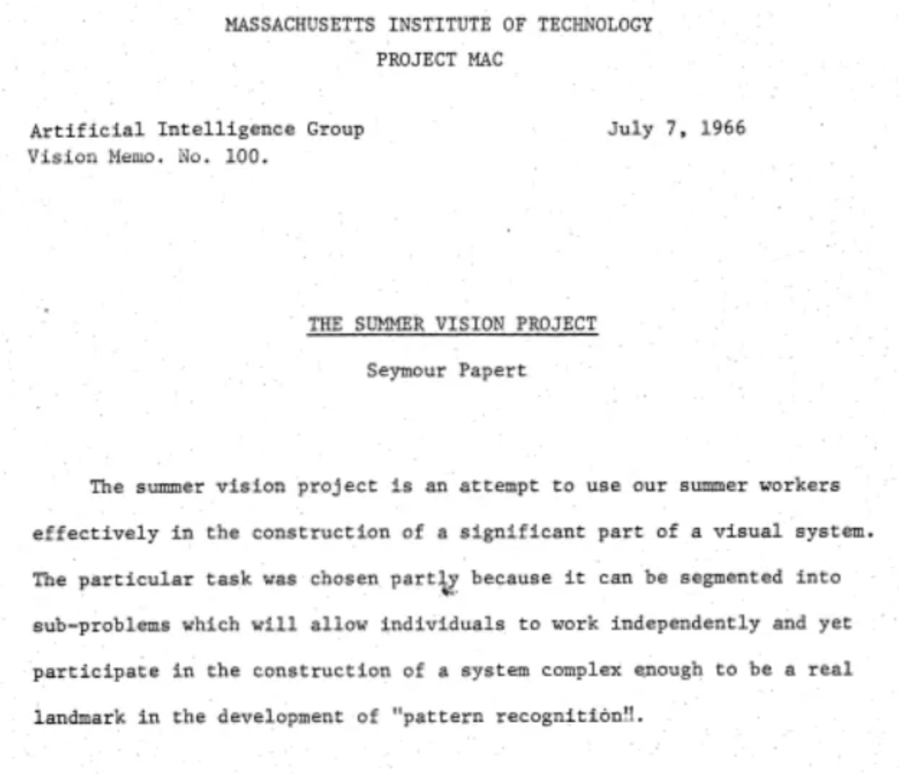
1966- The summer Vision ProJect
Source: https://medium.com/data-and-beyond/a-historical-investigation-into-the-beginning-of-computer-vision-8e86858254bd

Slide 12
1974 – Optical Character Recognition (OCR)
In 1974, optical character recognition (OCR) technology was introduced and according to IBM, OCR “could recognize text printed in any font or typeface.” ^{[1]} This technology would eventually lend itself to “document and invoice processing, vehicle plate recognition, mobile payments, machine conversion and other common applications.”
Source: [1] https://www.ibm.com/topics/computer-vision

Slide 13
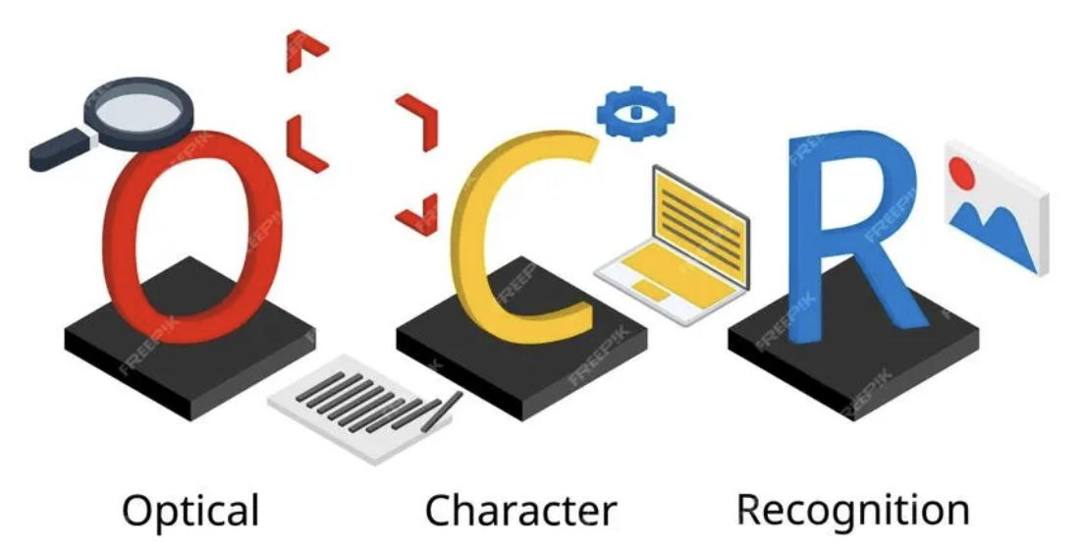
1974 – Optical Character Recognition (OCR)
Source: https://www.forbes.com/sites/technology/article/what-is-ocr-technology/

Slide 14
1976-1979 – Theory of Binocular Stereopsis
From 1976-1979, David Marr and Tomaso Poggio “developed a theory of how depth perception works in the brain through binocular stereopsis – the method by which the brain interprets different images from each eye to perceive depth. This laid the groundwork for 3D perception in computer vision.” ^{[2]}
Source: [2] https://www.turingpost.com/p/cvhistory2

Slide 15
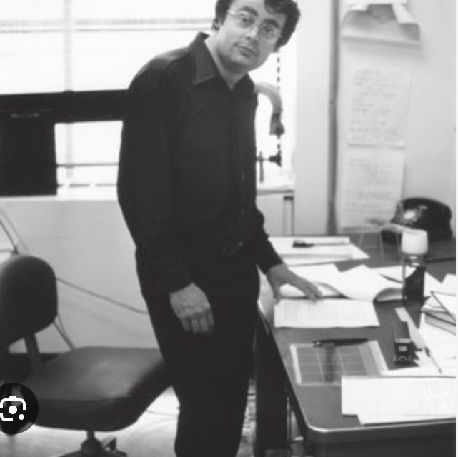
1976-1979 – Theory of Binocular Stereopsis
https://www.researchgate.net/publication/235626691_The_Vision_of_David_Marr

Slide 16
1979 - NeoCognitron
In 1979, inspired by Hubel and Wiesel’s research on cats, Japanese Professor Kunihiko Fukushima proposed the Neocognitron; a hierarchical multilayered neural network which “learns to recognize patterns by detecting simple features and combining them in high layers. Neocognitron is the precursor to our present-day convolutional neural networks (CNNs).” ^{[4]}
Source: [4] https://medium.com/data-and-beyond/a-historical-investigation-into-the-beginning-of-computer-vision-8e86858254bd

Slide 17
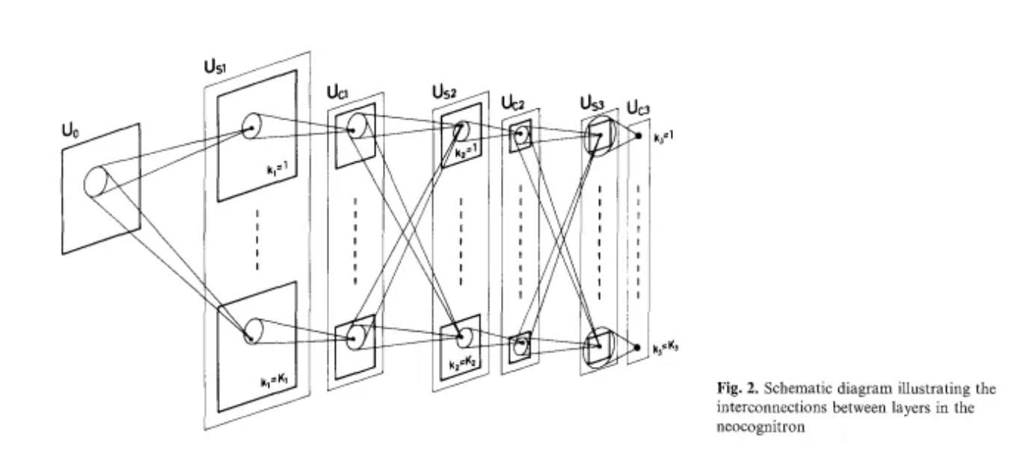
1979 - NeoCognitron
Source: https://medium.com/data-and-beyond/a-historical-investigation-into-the-beginning-of-computer-vision-8e86858254bd

Slide 18
1986 – Canny Edge Detector
In 1986, Australian computer scientist John F. Canny developed the Canny edge detector, an “edge detection operator that uses a multi-stage algorithm to detect a wide range of edges in images.” ^{[5]} Today the algorithm is part of Python’s OpenCV library, used for operations related to or on images.
Source: [5] https://medium.com/simply-dev/what-is-canny-edge-detection-cfefa272a8d0

Slide 19
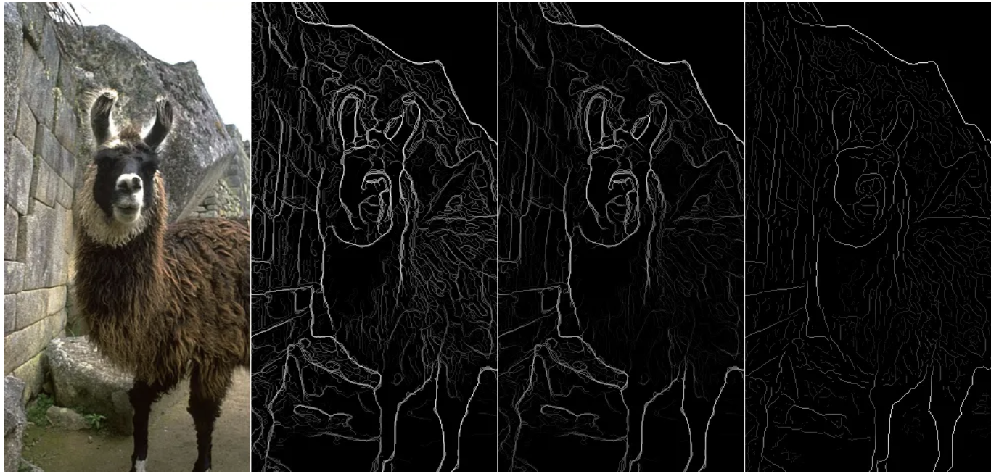
1986 – Canny Edge Detector
Source: https://medium.com/simply-dev/what-is-canny-edge-detection-cfefa272a8d0

Slide 20
1988- Active Contour Model
1988 The advent of the "Active Contour Model" (snakes) by Kass, Witkin and Terzopoulos allows for dynamic shape modeling in images.
A paper written by Mkass. A witkin. And D. Terzopoulos creates the concept of “snakes”. Snakes are energy minimizing splines for dynamic shape modeling that adaptively conform to the edges of an image. (Think like a snake game that you have to surround the picture of an object with excerpt as the energy to move around the object decreases the efficiency of the snake to locate the boundaries of the object improve) (NOTE: this research didn’t become popular until about 1993)
Source: M. Kass, A. Witkin, and D. Terzopoulos, “Snakes: Active Contour Models,” International Journal of Computer Vision, pp. 321–331, 1987

Slide 21
1989 - Backpropagation
In 1989, “Yann LeCun showcased the first groundbreaking application of backpropagation at Bell Labs. Through his work, he introduced backpropagation to convolutional neural networks (CNNs) as a means to analyze handwritten digits.” ^{[4]}
Source: [4] https://medium.com/data-and-beyond/a-historical-investigation-into-the-beginning-of-computer-vision-8e86858254bd

Slide 22
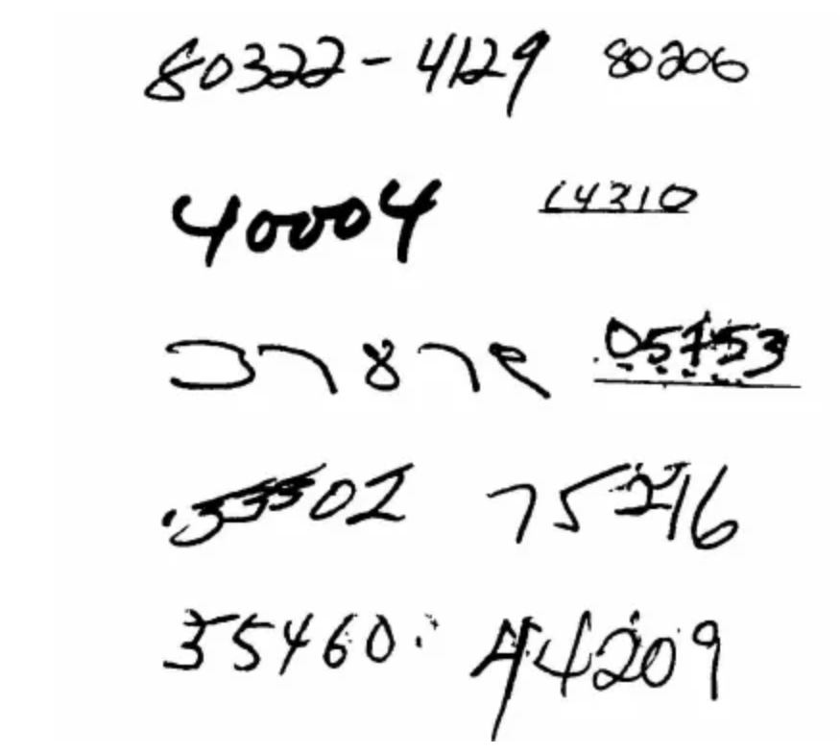
1989 - Backpropagation
Source: https://medium.com/data-and-beyond/a-historical-investigation-into-the-beginning-of-computer-vision-8e86858254bd

Slide 23
1991- Eignefaces Method for facial Recognition
“We have developed a near-real-time computer system that can locate and track a subject's head, and then recognize the person by comparing characteristics of the face to those of known individuals. The computational approach taken in this system is motivated by both physiology and information theory, as well as by the practical requirements of near-real-time performance and accuracy “ Source: https://direct.mit.edu/jocn/article/3/1/71/3025/Eigenfaces-for-Recognition Links to an external site. Turk, M., & Pentland, A. (1991). "Eigenfaces for Recognition." Journal of Cognitive Neuroscience, 3(1), 71-86.

Slide 24
1998 Introduction of the Active Appearance Models (AAMs)
Statistical models of the shape and appearance of an object called AAMs exploit the similarity of the optimization problem. This allows the machine to “explain” the appearance of a model as a set of parameters useful for high level interpretation. Source: https://www.cs.cmu.edu/~efros/courses/AP06/Papers/cootes-eccv-98.pdf Links to an external site. Cootes, T. F., Edwards, G. J., & Taylor, C. J. (1998). "Active Appearance Models." Proceedings of the European Conference on Computer Vision (ECCV 1998).

Slide 25
2001: Introduction of the Viola-Jones Object Detection Framework
“This work is distinguished by three key contributions. The first is the introduction of a new image representation called the “Integral Image” which allows the features used by our detector to be computed very quickly. The second is a learning algorithm, based on AdaBoost, which selects a small number of critical visual features from a larger set and yields extremely efficient classifiers[6]. The third contribution is a method for combining increasingly more complex classifiers in a “cascade” which allows background regions of the image to be quickly discarded while spending more computation on promising object-like regions” Source: Viola, P., & Jones, M. (2001). "Rapid Object Detection using a Boosted Cascade of Simple Features." Proceedings of the 2001 IEEE Computer Society Conference on Computer Vision and Pattern Recognition (CVPR 2001).

Slide 26
2004: Invention of the Bag of Words Model for Image Classification
“present(s) results for simultaneously classifying seven semantic visual categories. These results clearly demonstrate that the method is robust to back- ground clutter and produces good categorization accuracy even without exploiting geometric information.” (In order to classify the increasing number of images available from cell phones the bag of words method assigns classifications to images) Source: https://www.cs.cmu.edu/~efros/courses/LBMV07/Papers/csurka-eccv-04.pdf
Links to an external site. Csurka, G., Dance, C. R., Fan, L., Willamowski, J., & Bray, C. (2004). "Visual Categorization with Bags of Keypoints." Workshop on Statistical Learning in Computer Vision, ECCV 2004

Slide 27
2004: Introduction of SIFT (Scale-Invariant Feature Transform)
“The recognition proceeds by matching individual features to a database of features from known objects using a fast nearest-neighbor algorithm, followed by a Hough transform to identify clusters belonging to a single object, and finally performing verification through least-squares solution for consistent pose parameters. This approach to recognition can robustly identify objects among clutter and occlusion while achieving near real-time performance.” (The computer can recognize images from different angles in different positions under different lighting by referring to a database of images to speed up the processes.)
Source: https://www.cs.ubc.ca/~lowe/papers/ijcv04.pdf Lowe, D. G. (2004). "Distinctive Image Features from Scale-Invariant Keypoints." International Journal of Computer Vision, 60(2), 91-110.

Slide 28
2005: Introduction of the Histogram of Oriented Gradients (HOG) Descriptor
“After reviewing existing edge and gradient based descriptors, we show experimentally that grids of Histograms of Oriented Gradient (HOG) descriptors significantly outperform existing feature sets for human detection.” (HOG becomes a fundamental technique for pedestrian detection.) Source: https://lear.inrialpes.fr/people/triggs/pubs/Dalal-cvpr05.pdf Links to an external site. Dalal, N., & Triggs, B. (2005). "Histograms of Oriented Gradients for Human Detection." Proceedings of the IEEE Conference on Computer Vision and Pattern Recognition (CVPR 2005). Research and development began earlier but culminated in a 2005 publication.

Slide 29
2006: ImageNet Database Launch
“We introduce here a new database called “ImageNet”, a large-scale ontology of images built upon the backbone of the WordNet structure. ImageNet aims to populate the majority of the 80,000 synsets of WordNet with an average of 500-1000 clean and full resolution images” Source: https://www.image-net.org/static_files/papers/imagenet_cvpr09.pdf Deng, J., Dong, W., Socher, R., Li, L.-J., Li, K., & Fei-Fei, L. (2009). "ImageNet: A Large-Scale Hierarchical Image Database." Proceedings of the IEEE Conference on Computer Vision and Pattern Recognition (CVPR 2009). The project began earlier, but its significant impact started with the 2009 publication.

Slide 30
2006: Introduction of the Conditional Random Fields (CRFs) for Structured Prediction
CRFs become popularized for labeling sequencing data in image segmentation. CRFs are a statistical model that consider not just the individual pixels but also the relationships between neighboring pixels allowing the image to account for context. Source: https://www.cs.columbia.edu/~jebara/6772/papers/crf.pdf Lafferty, J., McCallum, A., & Pereira, F. (2001). "Conditional Random Fields: Probabilistic Models for Segmenting and Labeling Sequence Data." Proceedings of the International Conference on Machine Learning (ICML 2001).

Slide 31
2009: Development of Deep Convolutional Neural Networks (CNNs) for Image Recognition
Resurgence in an interest in CNN’s culminates with a 15.3% error rate in the ILSVRC-2012 competition compared to a 26.2% error rate of the second best entry. Source: Krizhevsky, A., Sutskever, I., & Hinton, G. E. (2012). "ImageNet Classification with Deep Convolutional Neural Networks." Advances in Neural Information Processing Systems (NIPS 2012). While this work was published in 2012, it was built on developments in the late 2000s, with key research occurring in 2009.

Slide 32
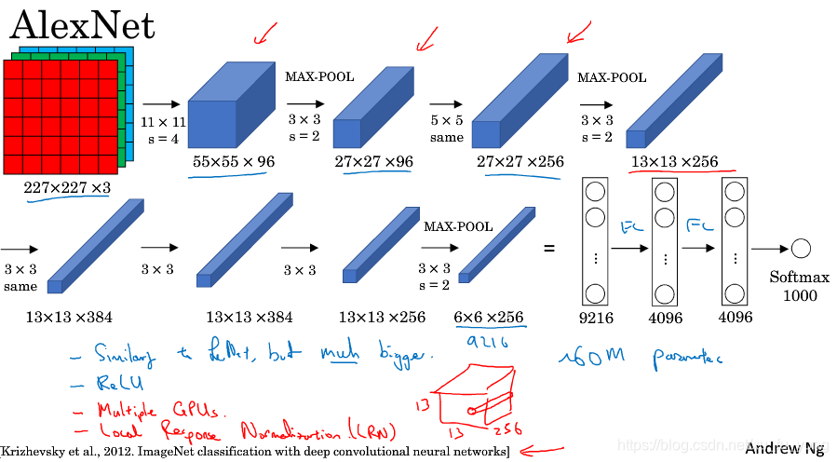
2012: Alexnet Model
The AlexNet model, based on deep convolutional neural networks (CNNs), wins the ImageNet competition, demonstrating the power of deep learning in vision tasks.
Source:
Wikipedia contributors. (2024, April 25). ImageNet. In Wikipedia, The Free Encyclopedia. Retrieved 17:55, August 23, 2024, from https://en.wikipedia.org/w/index.php?title=ImageNet&oldid=1220649686
ImageNet Large Scale Visual Recognition Challenge 2012 web page: https://image-net.org/challenges/LSVRC/2012/index#cite
AlexNet: The First CNN to win Image Net: https://www.mygreatlearning.com/blog/alexnet-the-first-cnn-to-win-image-net/
This Photo by Unknown Author is licensed under CC BY-SA

Slide 33
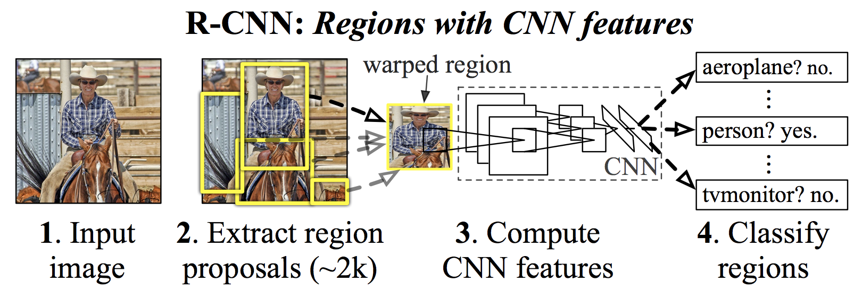
2013: Region-based Convolutional Neural Network (R-CNN)
The introduction of the Region-based Convolutional Neural Network (R-CNN) improves object detection by combining CNNs with region proposals.
"Ross Girshick et al in 2013 proposed an architecture called R-CNN (Region-based CNN) to deal with this challenge of object detection. This R-CNN architecture uses the selective search algorithm that generates approximately 2000 region proposals. These 2000 region proposals are then provided to CNN architecture that computes CNN features. These features are then passed in an SVM model to classify the object present in the region proposal." - Geek for Geeks. (2023, August 1).
Source:
https://www.geeksforgeeks.org/r-cnn-region-based-cnns/
"Rich feature hierarchies for accurate object detection and semantic segmentation" - Ross Girshick et al in 2013 https://arxiv.org/abs/1311.2524v5
This Photo by Unknown Author is licensed under CC BY

Slide 34

2014: Google introduces the first neural network capable of generating captions for images
In 2014, Google introduces the first neural network capable of generating captions for images, bridging computer vision and natural language processing.
"Automatically describing the content of an image is a fundamental problem in artificial intelligence that connects computer vision and natural language processing. In this paper, we present a generative model based on a deep recurrent architecture that combines recent advances in computer vision and machine translation and that can be used to generate natural sentences describing an image. The model is trained to maximize the likelihood of the target description sentence given the training image." - Vinyals et al, 2014
Source:
"Show and Tell: A Neural Image Caption Generator" by Vinyals et al, 2014 (https://arxiv.org/abs/1411.4555)

Slide 35
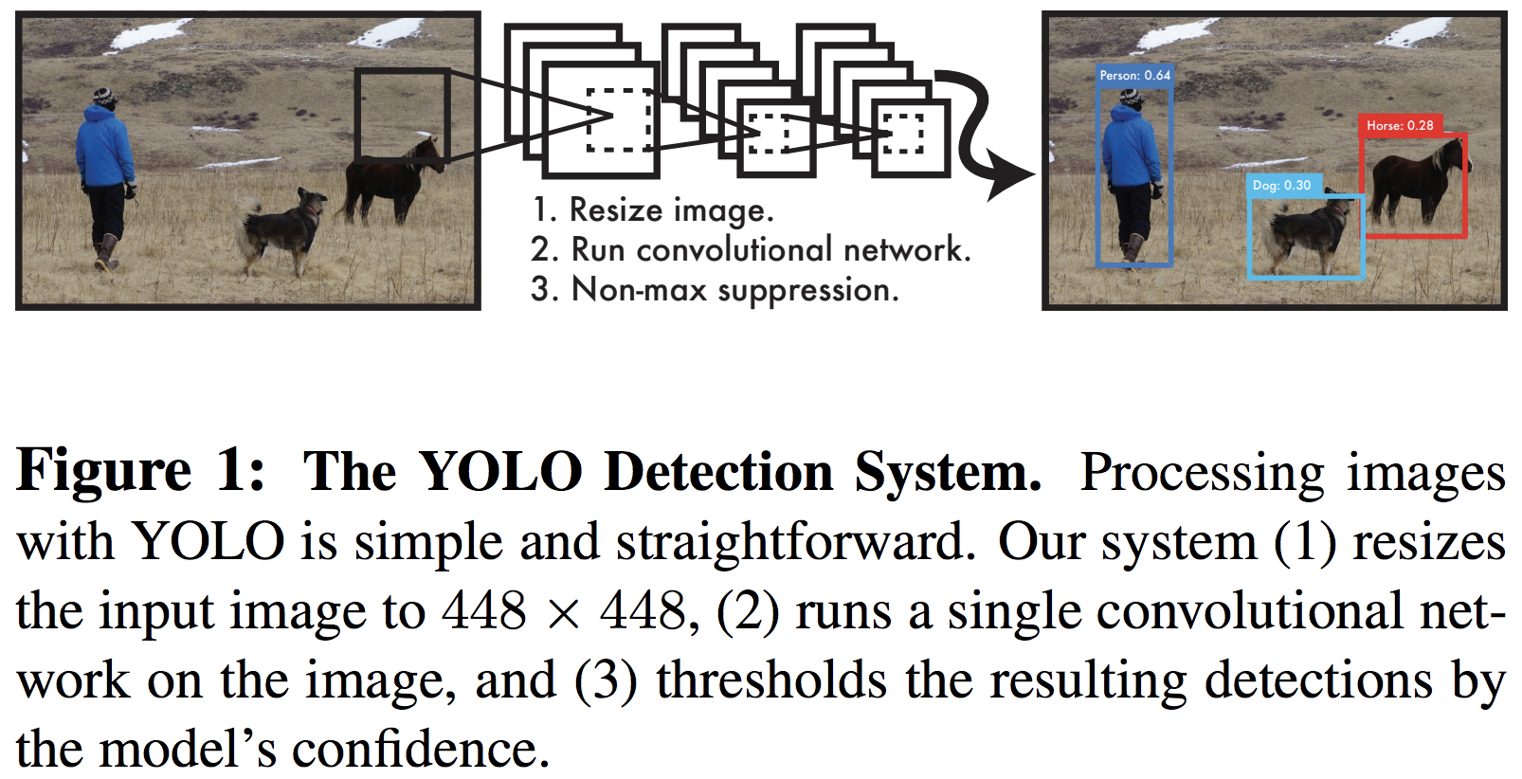
2015: The development of the You Only Look Once (YOLO) algorithm
In 2015, the development of the You Only Look Once (YOLO) algorithm by Joseph Redmon enables real-time object detection with high accuracy.
"We present YOLO, a new approach to object detection. Prior work on object detection repurposes classifiers to perform detection. Instead, we frame object detection as a regression problem to spatially separated bounding boxes and associated class probabilities. A single neural network predicts bounding boxes and class probabilities directly from full images in one evaluation. Since the whole detection pipeline is a single network, it can be optimized end-to-end directly on detection performance." - Redmon et al., 2015
Source:
"You Only Look Once: Unified, Real-Time Object Detection" by Redmon et al., 2015 (https://arxiv.org/abs/1506.02640)
This Photo by Unknown Author is licensed under CC BY

Slide 36
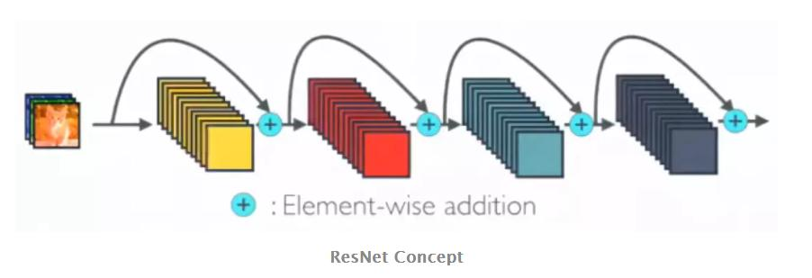
2015: The ResNet model
The ResNet model, which introduces deep residual learning, wins the ImageNet competition, setting new benchmarks in image classification.
Sources:
Microsoft researchers win ImageNet computer vision challenge - https://blogs.microsoft.com/ai/microsoft-researchers-win-imagenet-computer-vision-challenge/
"Deep Residual Learning for Image Recognition" by He et al., 2015 (https://arxiv.org/abs/1512.03385)
This Photo by Unknown Author is licensed under CC BY-SA

Slide 37

2016: AlphaGo
In 2016, AlphaGo, developed by DeepMind, made history by defeating Lee Sedol, a world champion Go player. This victory was a significant milestone for artificial intelligence, demonstrating the potential of deep learning and computer vision for complex tasks that require strategy, intuition, and creativity.
Source:
Google DeepMind: https://deepmind.google/technologies/alphago/
Wikipedia: https://en.wikipedia.org/wiki/AlphaGo_versus_Lee_Sedol
The New York Times: https://www.nytimes.com/2016/03/16/world/asia/korea-alphago-vs-lee-sedol-go.html1
This Photo by Unknown Author is licensed under CC BY-SA

Slide 38

2017-2018: Facebook releases the Detectron platform
Facebook releases the Detectron platform, making state-of-the-art object detection accessible to developers and researchers.
Sources:
https://www.infoq.com/news/2018/03/facebook-detectron-library/
https://www.analyticsvidhya.com/blog/2018/01/facebook-launched-detectron-platform-object-detection-research/

Slide 39
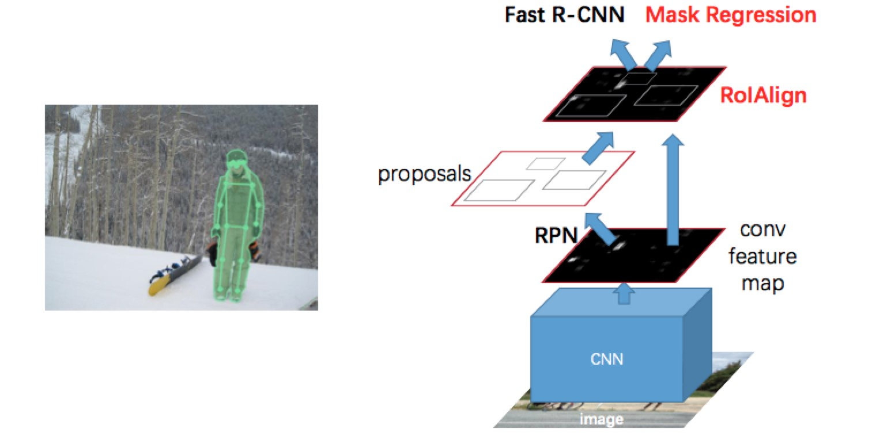
2018: Mask R-CNN
The debut of the Mask R-CNN algorithm allows for precise object segmentation and detection in images, further advancing computer vision applications.
Sources:
https://medium.com/@umerfarooq_26378/from-r-cnn-to-mask-r-cnn-d6367b196cfd
Wikipedia: https://en.wikipedia.org/wiki/Region_Based_Convolutional_Neural_Networks
https://pyimagesearch.com/2018/11/19/mask-r-cnn-with-opencv/
This Photo by Unknown Author is licensed under CC BY-NC-ND

Slide 40
2019: The introduction of transformers to computer vision
Vision Transformers (ViT) was first introduced in 2020, marking a shift in computer vision by applying transformers to image processing, similar to how they are used in NLP tasks. This architecture allowed for holistic image analysis and outperformed CNNs in various tasks.
Sources:
https://ar5iv.org/abs/2205.11239v1 https://viso.ai/deep-learning/vision-transformer-vit/ https://visionplatform.ai/vision-transformers-vit/

Slide 41
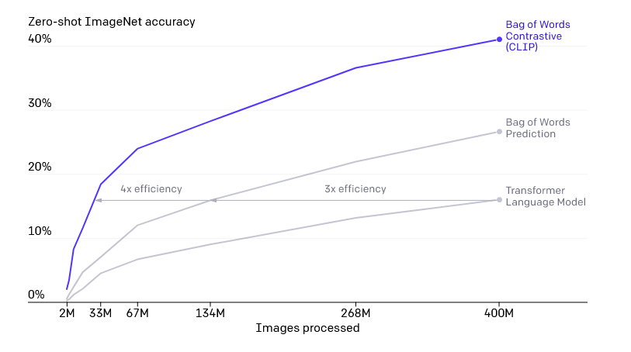
2020: The development of NeRF (Neural Radiance Fields)
NeRF was introduced in 2020 by researchers at UC Berkeley, allowing the synthesis of photorealistic 3D scenes from 2D images through volumetric scene representation.
Source: https://blogs.novita.ai/everything-you-need-to-know-about-openai-clip/

Slide 42
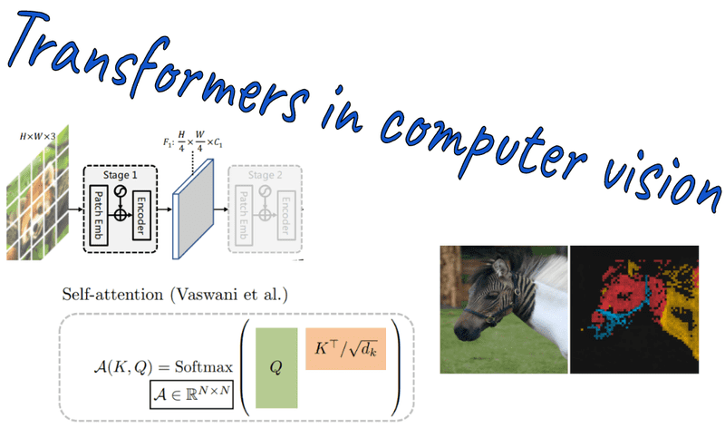
2021: Facebook AI Research (FAIR) releases the DINO model
Facebook AI (now Meta) introduced the DINO model in 2021, demonstrating significant advancements in self-supervised learning, particularly in training Vision Transformers without labeled data.
Source: https://theaisummer.com/transformers-computer-vision/

Slide 43
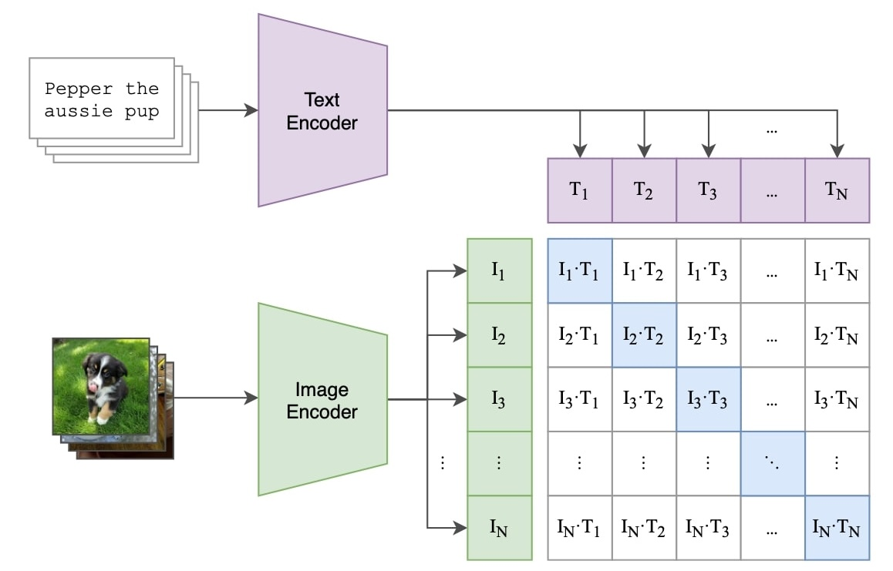
2021: The introduction of CLIP-based models by OpenAI
OpenAI's CLIP, introduced in early 2021, significantly advanced multi-modal AI by training on image-text pairs and excelling in zero-shot learning tasks.
Sources: https://openai.com/index/clip/?ref=ai-weirdness https://unfoldai.com/discovering-clip/

Slide 44
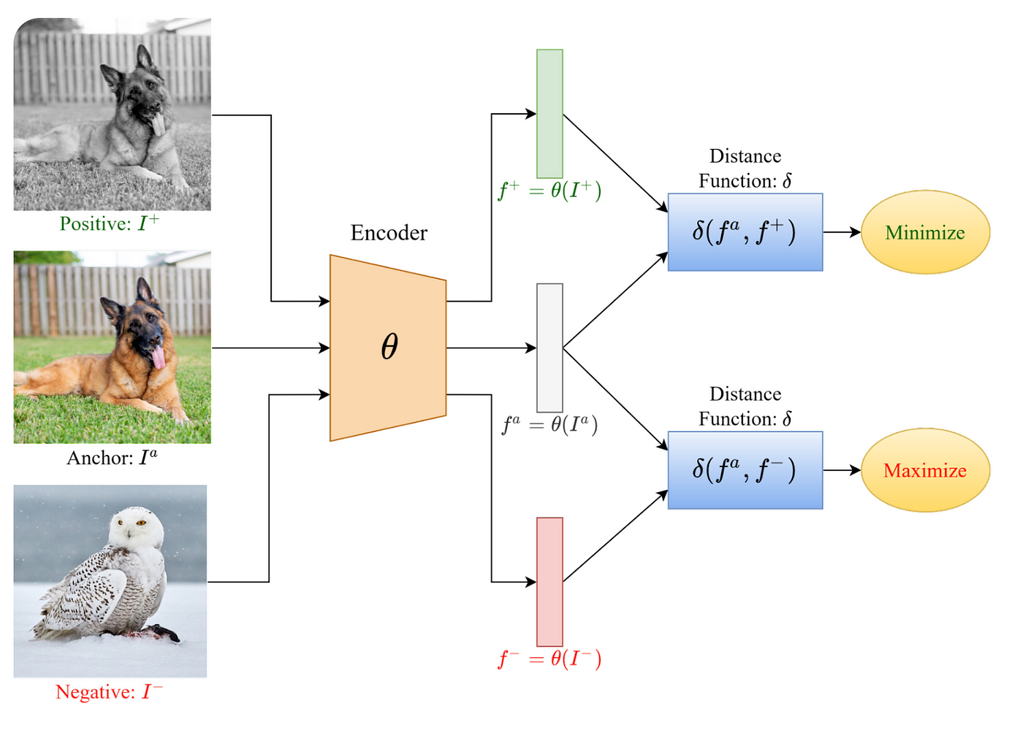
2022: NVIDIA develops the Omniverse platform
NVIDIA's Omniverse platform, launched in 2022, integrates real-time photorealistic rendering with AI-powered simulations, primarily targeted at industrial and creative applications.
Source: https://blogs.novita.ai/everything-you-need-to-know-about-openai-clip/

Slide 45
2022: The launch of OpenAI's DALL-E 2
DALL-E 2, released by OpenAI in 2022, showcases the ability to generate photorealistic images from text prompts, advancing the field of generative AI.
Source:https://openai.com/index/hierarchical-text-conditional-image-generation-with-clip-latents/

Slide 46
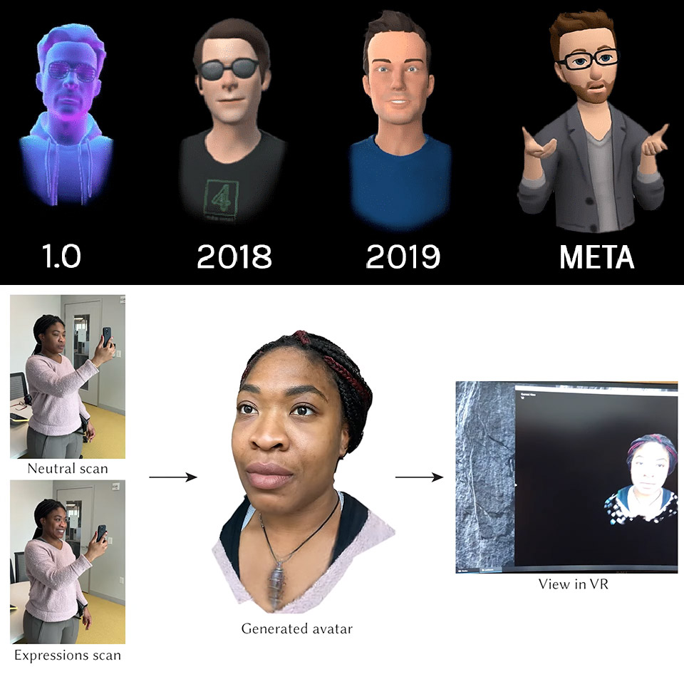
2022: Meta AI introduces a method for reconstructing 3D human avatars from a single 2D image using deep learning and computer vision.
Meta AI introduced innovative techniques in 2022 to reconstruct 3D human avatars from a single 2D image, using deep learning and computer vision methods.
Source:https://blogs.novita.ai/everything-you-need-to-know-about-openai-clip/

Slide 47
2023: The development of Meta's Segment Anything Model (SAM), which generalizes across segmentation tasks without fine-tuning.
Meta's Segment Anything Model (SAM), introduced in 2023, is designed to generalize across various segmentation tasks without requiring fine-tuning, representing a significant advance in computer vision.
Source: https://blogs.novita.ai/everything-you-need-to-know-about-openai-clip/

Slide 48
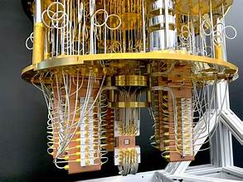
2023:The first successful application of quantum computing to solve certain problems in computer vision is demonstrated, opening new research avenues.
Initial research in 2023 demonstrated quantum computing's potential to address specific challenges in computer vision, marking a promising new avenue for exploration.
Source: https://www.youtube.com/watch?v=LEslWkeY1tk

Slide 49
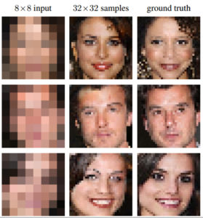
2023: Researchers develop AI models capable of generating detailed images from very low-resolution inputs, setting a new standard for super-resolution.
These developments were showcased in several prominent studies and challenges, such as the NTIRE 2023 challenge, which focused on pushing the boundaries of super-resolution using deep learning methods. Notably, techniques like diffusion models, generative adversarial networks (GANs), and novel pixel-based approaches have been employed to enhance the quality and detail of upscaled images, overcoming previous limitations related to blurriness and loss of detail.
Source: https://openaccess.thecvf.com/content/CVPR2023/papers/Gao_Implicit_Diffusion_Models_for_Continuous_Super-Resolution_CVPR_2023_paper.pdf

Slide 50

2024 - Advances in neural radiance fields (NeRF) enable real-time 3D scene reconstruction from sparse video data
Research in 2024 introduced systems like NeRF-VO, which integrated sparse visual odometry with NeRF to achieve highly accurate camera tracking and dense 3D scene reconstruction in real time. This was accomplished by optimizing neural representations with limited data, demonstrating significant improvements over previous state-of-the-art methods​.
Sources:
https://xingxingzuo.github.io/nerfvo/
Jiahao Chen, Yipeng Qin, Lingjie Liu, Jiangbo Lu, Guanbin Li; Proceedings of the IEEE/CVF Conference on Computer Vision and Pattern Recognition (CVPR), 2024, pp. 19436-19446
https://openaccess.thecvf.com/content/CVPR2024/html/Chen_NeRF-HuGS_Improved_Neural_Radiance_Fields_in_Non-static_Scenes_Using_Heuristics-Guided_CVPR_2024_paper.html

Slide 51

2024: AI-powered computer vision models achieve near-human performance in medical image diagnosis, reducing the need for human intervention
AI tools like Viz.ai and Zebra Medical Vision are already making strides in this area. These tools assist radiologists in detecting abnormalities, such as early signs of cancer or neurological conditions, from imaging data like CT scans and MRIs. While these AI systems have not completely replaced human radiologists, they have reduced the burden on healthcare professionals by providing faster and more reliable preliminary analyses. This collaboration between AI and human expertise is improving patient outcomes by enabling quicker and more accurate diagnosis and treatment.
Source:
AI in Healthcare: Top 5 Medical AI Tools We Use in 2024 - https://www.techopedia.com/ai-in-healthcare-top-medical-ai-tools
Top AI Medical Imaging tools for Healthcare Analytics – 2024 - https://www.factspan.com/blogs/ai-medical-imaging-tools-transforming-healthcare-analytics-in-2024/
Revolutionising Medical Imaging with AI and Big Data Analytics - https://openmedscience.com/revolutionising-medical-imaging-with-ai-and-big-data-analytics/

Slide 52
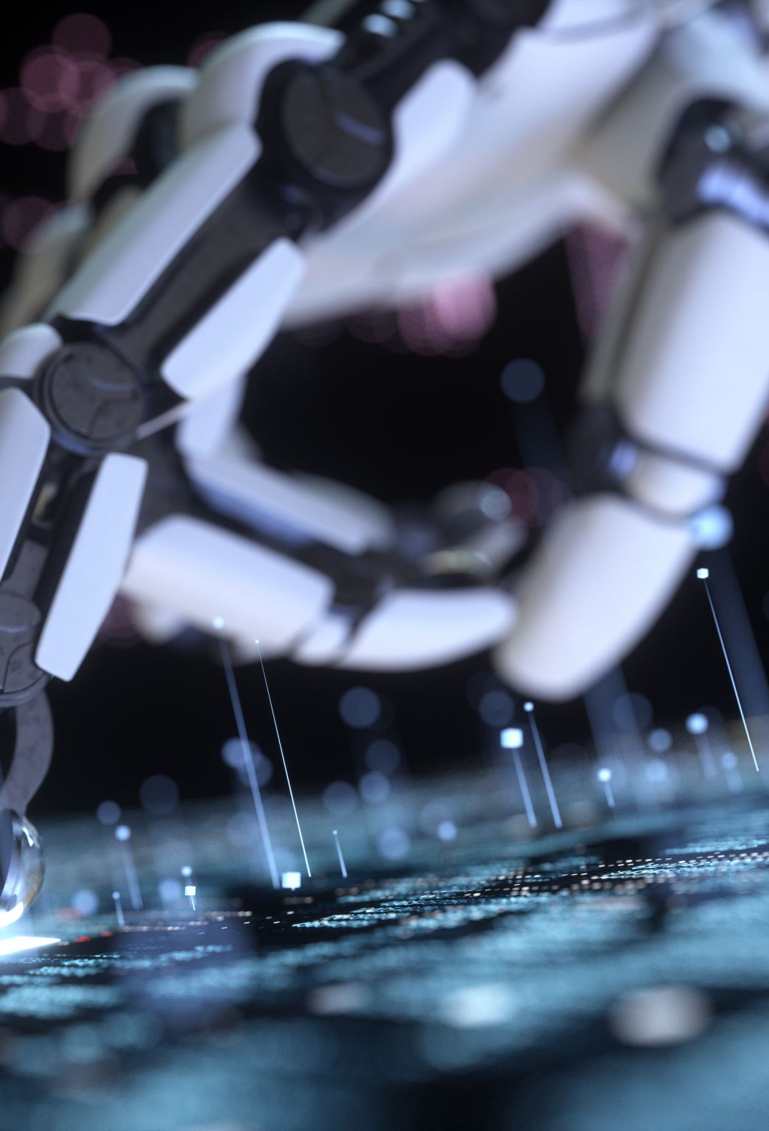
2024: AI-based video editing tools that can automatically identify and enhance objects in video footage become commercially available
Platforms like Final Cut Pro, Movavi Video Editor, and Runway are using AI to streamline and automate complex editing tasks. These tools can automatically detect and manipulate objects within video frames, making the editing process more efficient and accessible, even for users with limited technical skills. The AI features include object removal, color correction, and even generating video content based on text prompts.
Source:
​The best AI video editors - https://www.creativebloq.com/features/best-ai-video-editing-tools
12 Best AI Video Editors 2024 (with Video Demos) - https://nerdynav.com/best-ai-video-editors/

Slide 53

2024: Research in computer vision achieves breakthroughs in understanding dynamic scenes, enabling better autonomous vehicle navigation
Sources:
Computer Vision Applications for Autonomous Vehicles - https://www.mdpi.com/journal/electronics/special_issues/262Y6B2EBZ
Autonomous Vehicles: Evolution of Artificial Intelligence and Learning Algorithms - https://ar5iv.labs.arxiv.org/html/2402.17690

Slide 54
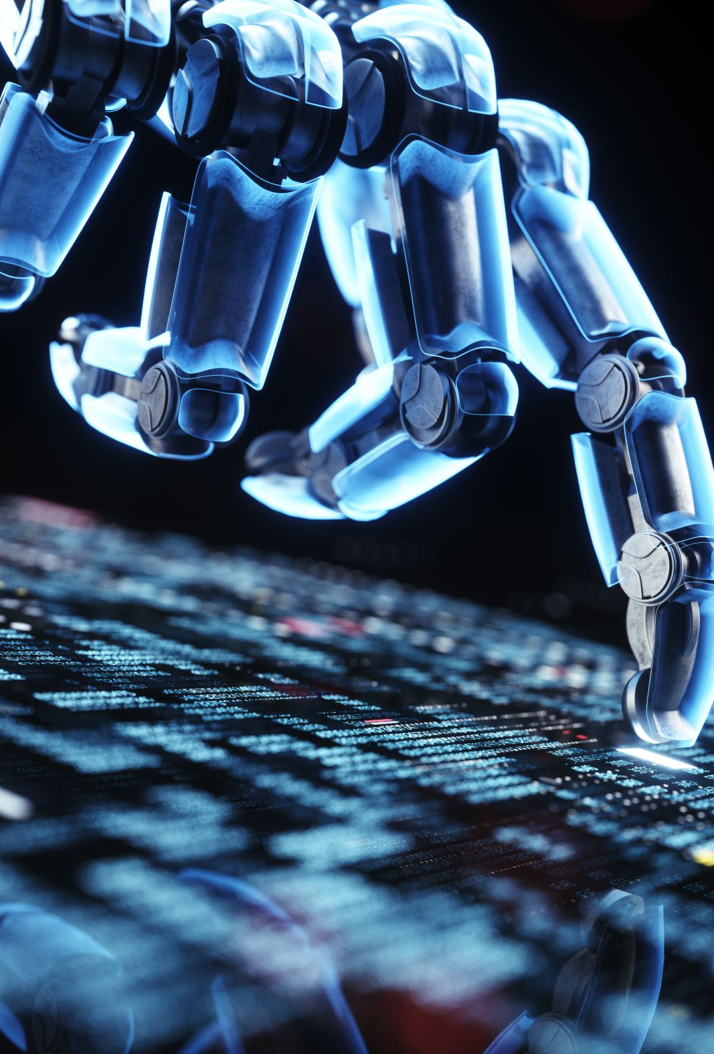
2024: The development of bio-inspired vision algorithms allows for more efficient processing in edge devices, such as drones and robotics
In 2024, significant advances have been made in bio-inspired vision algorithms, which have enhanced the efficiency of processing in edge devices such as drones and robotics. These algorithms, inspired by the biological functions of animal brains, have been implemented in neuromorphic systems that allow for more energy-efficient and faster processing compared to traditional methods. For example, drones equipped with neuromorphic vision systems can perceive and respond to their environment with remarkable speed and efficiency, making them ideal for applications in areas like greenhouse monitoring and warehouse management. This technology represents a critical step forward in enabling autonomous systems to operate in complex, real-world environments with minimal power consumption
Source:
The best AI video editors - https://www.creativebloq.com/features/best-ai-video-editing-tools
12 Best AI Video Editors 2024 (with Video Demos) - https://nerdynav.com/best-ai-video-editors/

Slide 55

2024: AI-assisted art tools leveraging computer vision achieve widespread use among creative professionals, blending artistic creativity with computational power
The integration of AI into art and design has been widely recognized in conferences like CVPR 2024, where the intersection of art and AI is celebrated through exhibitions and keynote addresses by prominent AI artists.
Sources:
CVPR 2024 to Showcase AI Art Gallery, Feature Prominent AI Artist Sofia Crespo as Keynote - https://cvpr.thecvf.com/Conferences/2024/News/AIArt
Special report: how design agencies are actually using AI in 2024 - https://www.creativeboom.com/features/special-report-how-design-agencies-are-using-ai-in-2024/

Slide 56

2024: Significant advancements in federated learning for computer vision improve privacy-preserving machine learning on edge devices
In 2024, there have been significant advancements in federated learning, particularly in the realm of computer vision, which have enhanced privacy-preserving machine learning on edge devices. These improvements have focused on making federated learning more efficient and secure for various computer vision tasks like object detection and image segmentation. The innovations include better aggregation optimization methods, handling data and model heterogeneity, and ensuring secure model training to prevent privacy breaches. These developments are crucial for applications where data privacy is paramount, such as in healthcare and edge computing environments.
Source:
https://fedvision.github.io/fedvision2024/
https://ar5iv.labs.arxiv.org/html/2301.01299

Slide 57
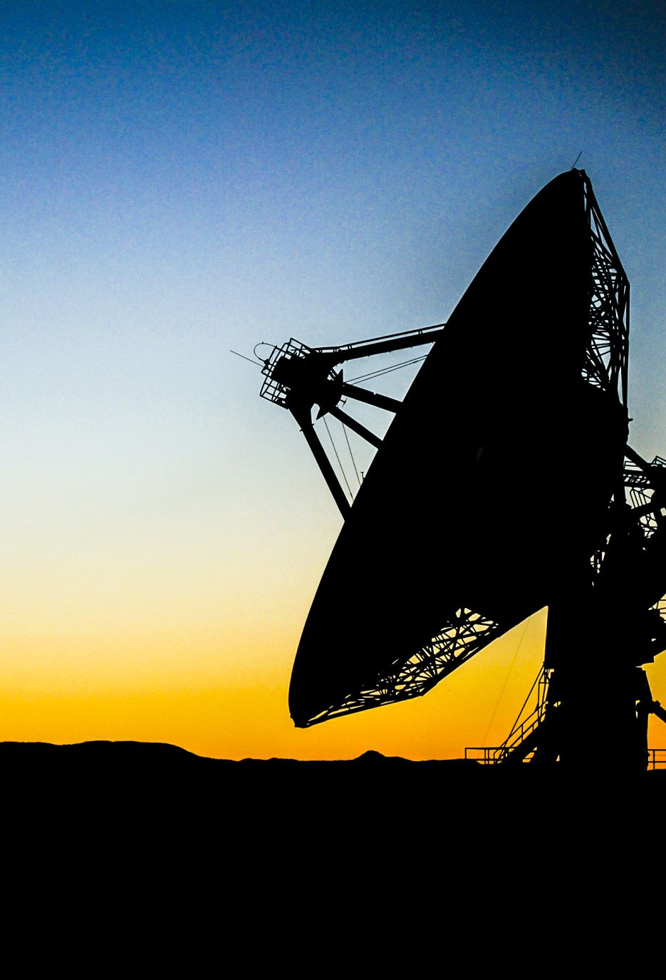
2024: New computer vision techniques are developed for analyzing and interpreting environmental changes from satellite imagery, aiding in climate research
Source:
BMO-sponsored Vector AI toolkit uses computer vision techniques to help fight climate change - https://about.bmo.com/bmo-sponsored-vector-ai-toolkit-uses-computer-vision-techniques-to-help-fight-climate-change/
https://arxiv.org/pdf/1910.11492
https://openaccess.thecvf.com/content/WACV2024/papers/Rad_Vision_Transfo

Slide 58

Present and Beyond
As we look to the future, the potential for computer vision to revolutionize industries, improve our daily lives, and solve complex problems is limitless. Whether it's enhancing medical diagnostics, enabling autonomous vehicles, or fostering new forms of artistic expression, the impact of computer vision will only continue to expand.

Slide 59
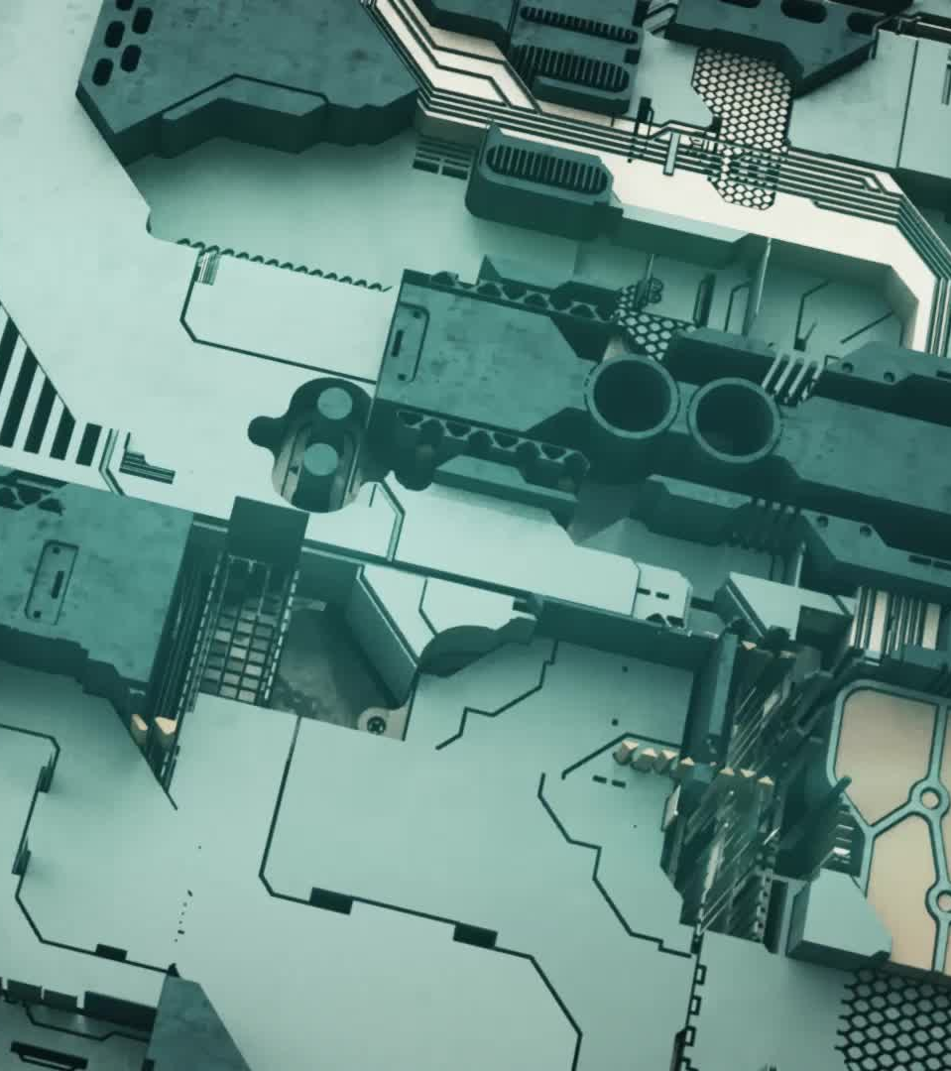
Thank You!
Thank you for joining us on this journey through the pivotal moments in the history of computer vision. From the early days of machine perception to the cutting-edge advancements of today, we have seen how this field has evolved and transformed our world. We look forward to seeing what the future holds for computer vision.

